Slide 1
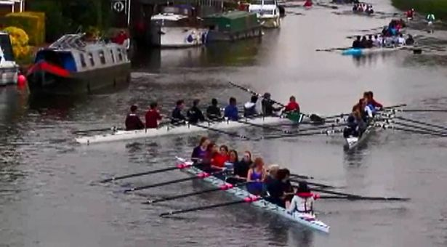
Getting the most out of water sessions (on a stupidly busy river)

Slide 2
Avoiding getting stuck in traffic (for too long)
What to do when you are
Not being a **** (too often)

Slide 3
Don’t get stuck! ☺
(Go out at lunchtime!)
Think ahead
Boat positioning
Anticipation

Slide 4
Boat positioning
Fast!
Slow

Slide 5
Boat positioning
Slow
Fast!
Fast!

Slide 6
Anticipation
Look at where other boats are *going* to be, not just where they are.
Keep an eye on where you will be
Be ready to move on when a chance presents
Don’t start getting straight and ready after a gap appears – be ready to go as soon as it does

Slide 7
Overtaking!
Be sure you can finish in time
Don’t be afraid to put in a burst
Safety (Please!)

Slide 8
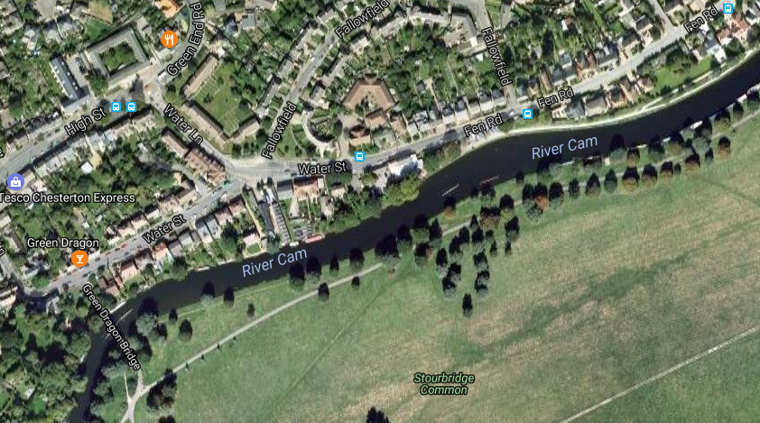

Slide 9
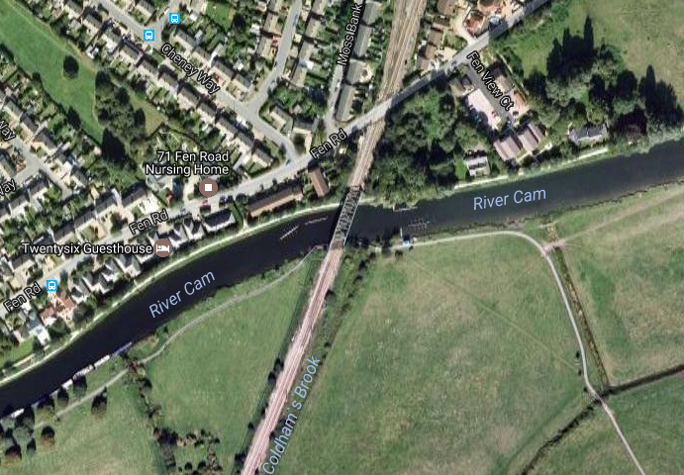

Slide 10
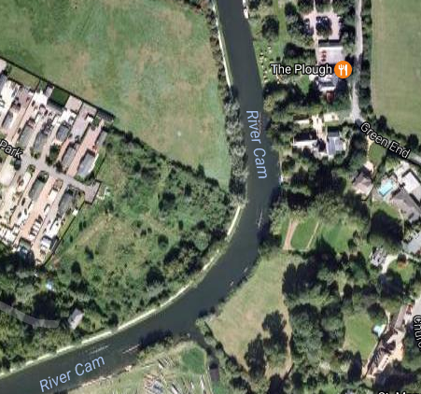
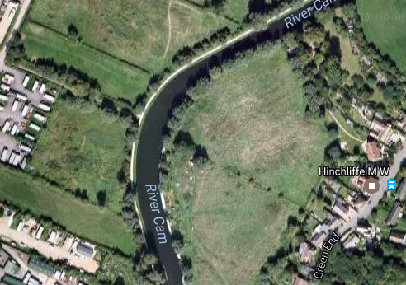
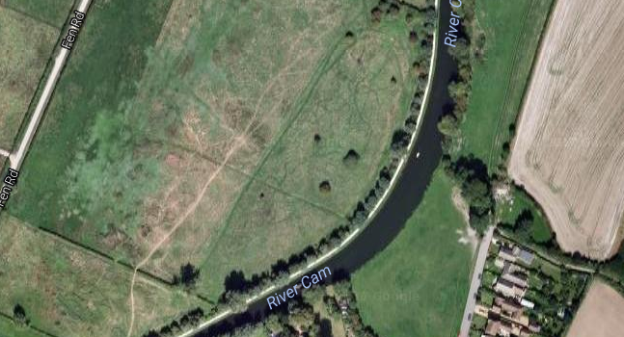

Slide 11
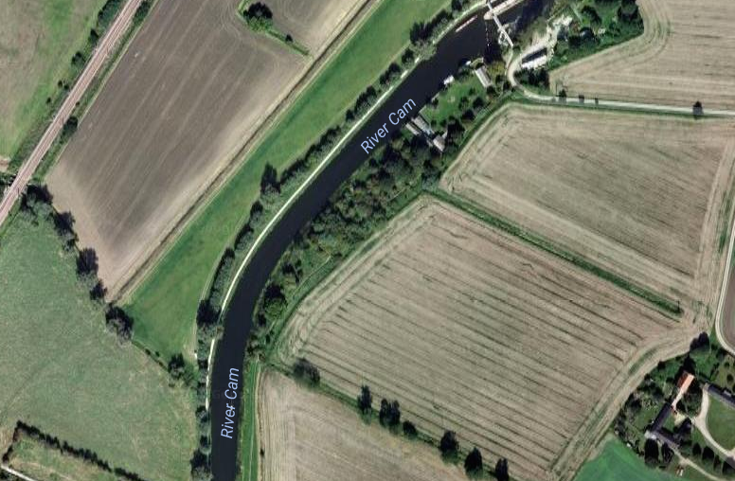

Slide 12
What if you do get stuck. ☹
Talk to your coach ahead of outings
Roll ups?
Backstops builds?
Don’t be afraid to abandon a drill to move on when traffic clears

Slide 13
The (unofficial) golden rule of the river
Don’t be a ****

Slide 14
The (unofficial) golden rule of the river
Don’t be a ****
Where possible, park so others can pass you safely
Don’t ram people by overtaking in silly places…

Slide 15
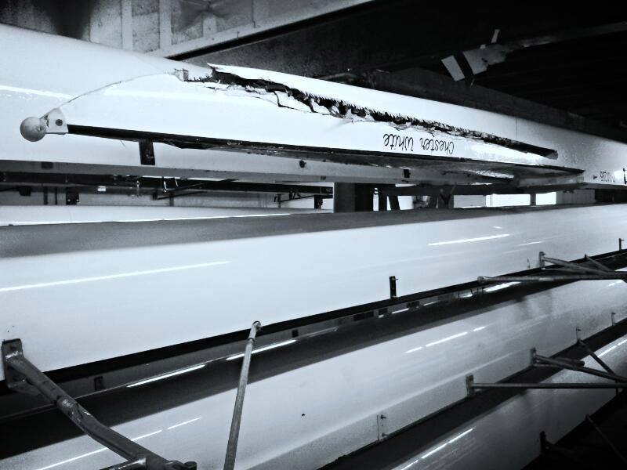

Slide 16
Coxing for town clubs
Not banned by CUCBC rules on out-of-hours rowing.
Great way to get more experience.
Talk to us after!

