Slide 1
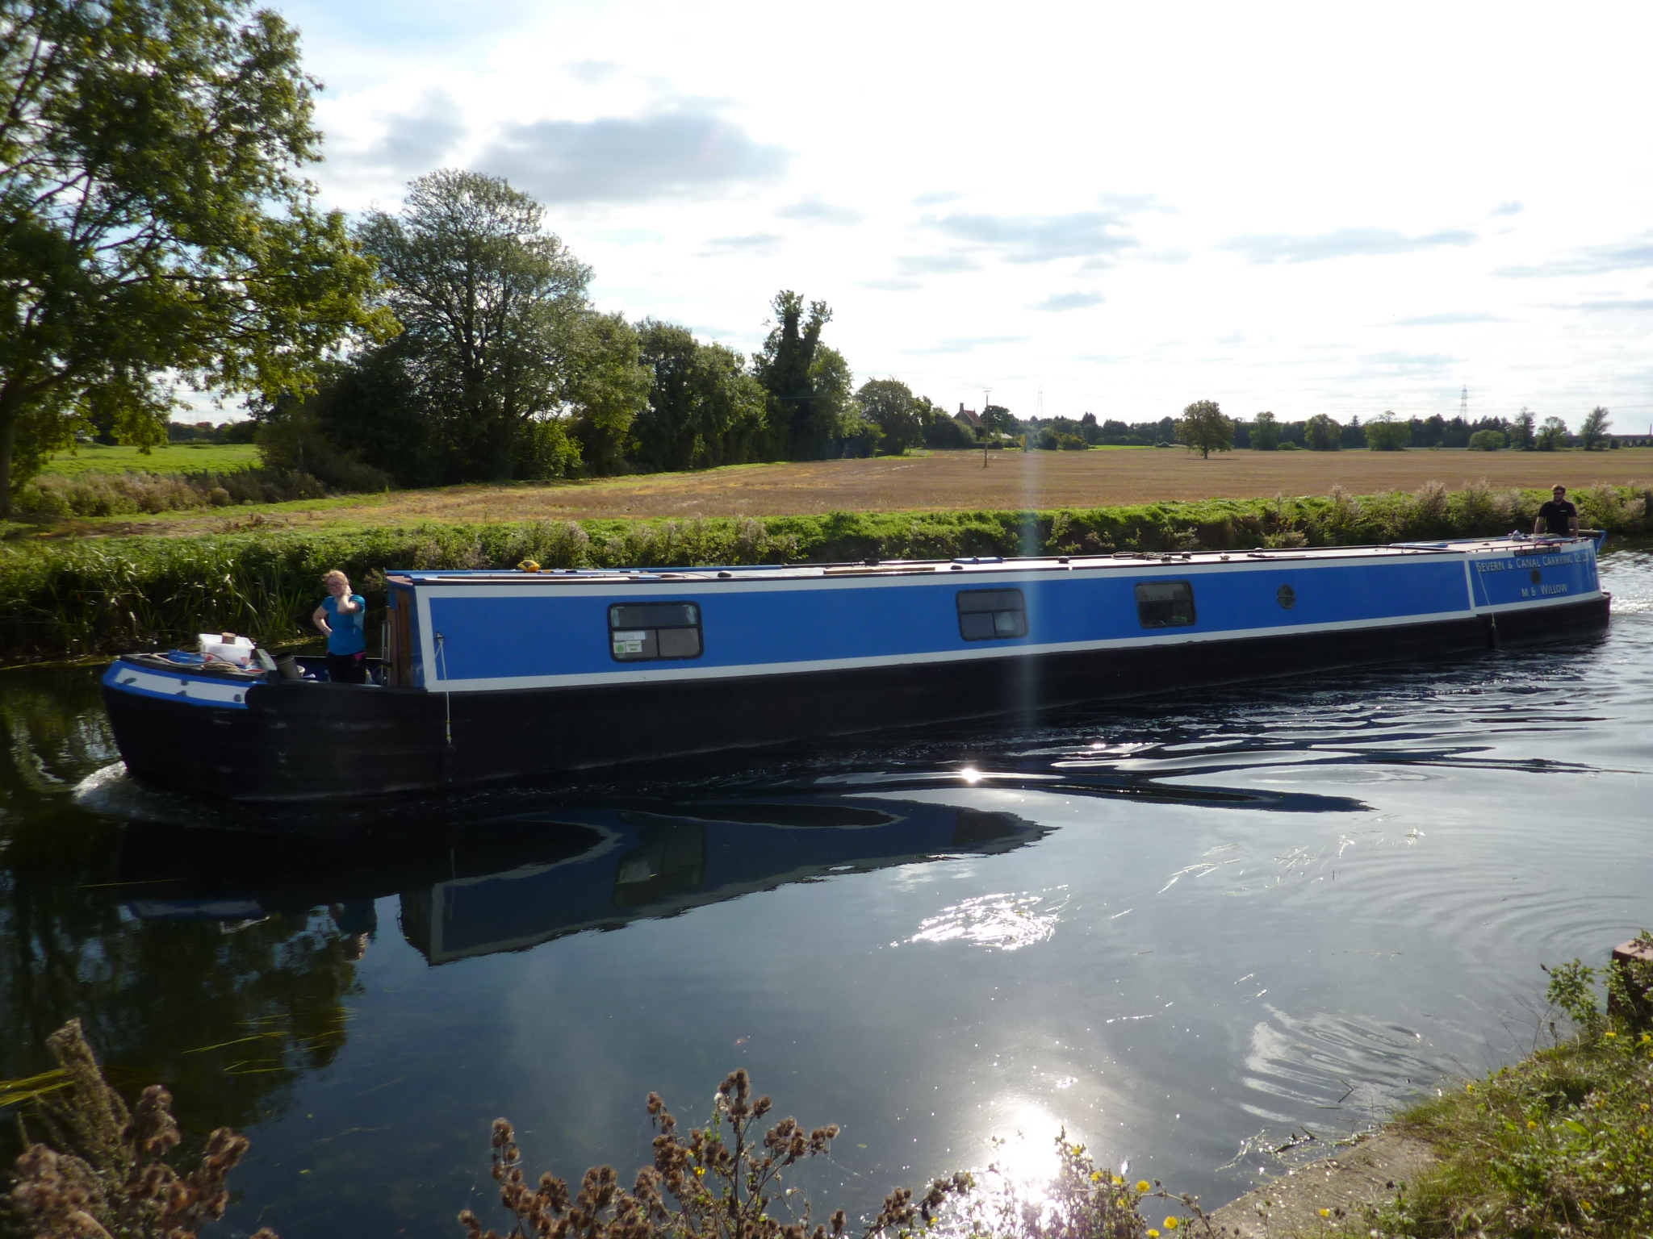

Slide 2
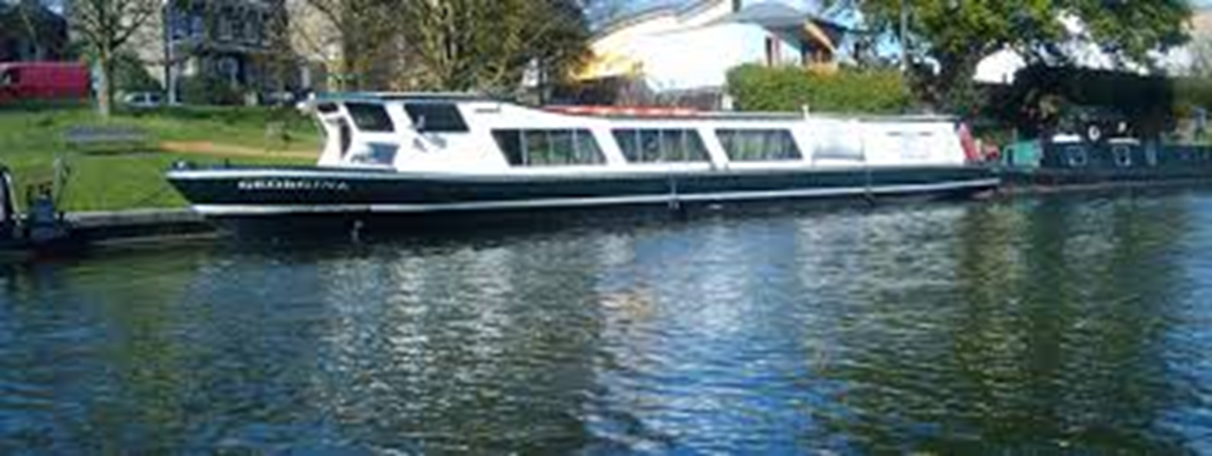

Slide 3
Moored Boats- Noise
Some noise is accepted
Excessive noise annoys many, especially in morning
Commands - Getting boat out
Rowers getting in
Cox boxes
ERGING MUSIC & SHOUTING

Slide 4
Moored Boats - Collisions
Can be very frequent (37 times in one morning once)
VERY loud inside – wake some people
Several boaters have babies and young children
Damage to blacking
Cost to repair
Can lead to rust
Damage to boats
One wooden cruiser sunk by rowing boat
Older boats

Slide 5
Moving Boats

Slide 6
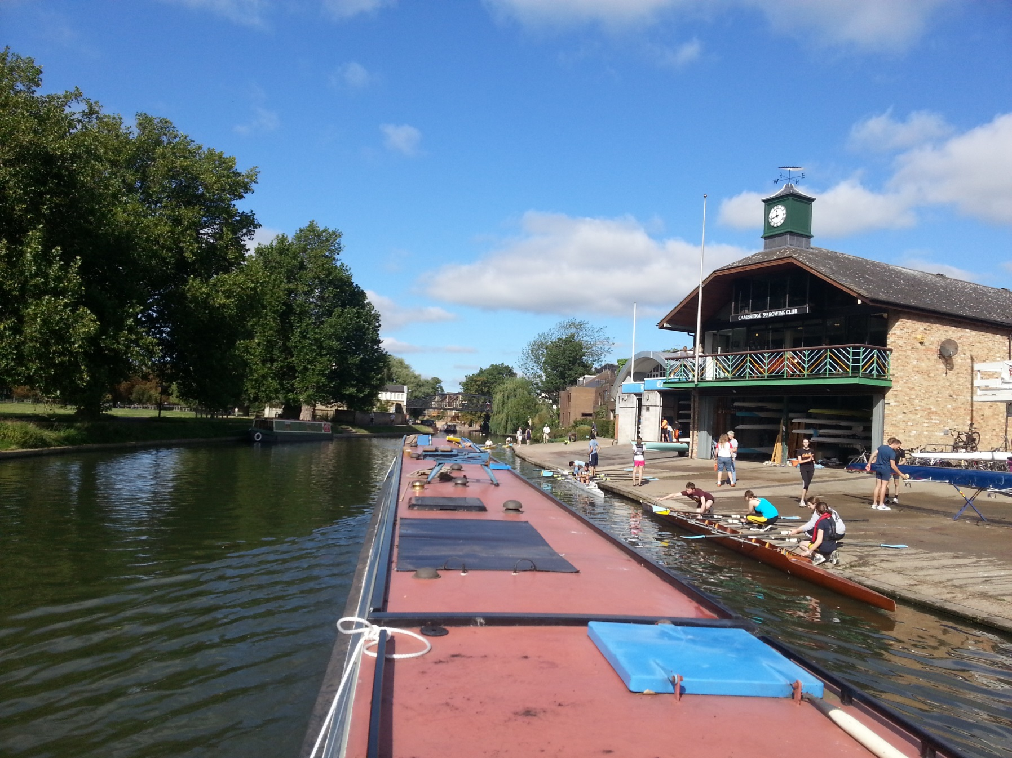
Moving Boats

Slide 7
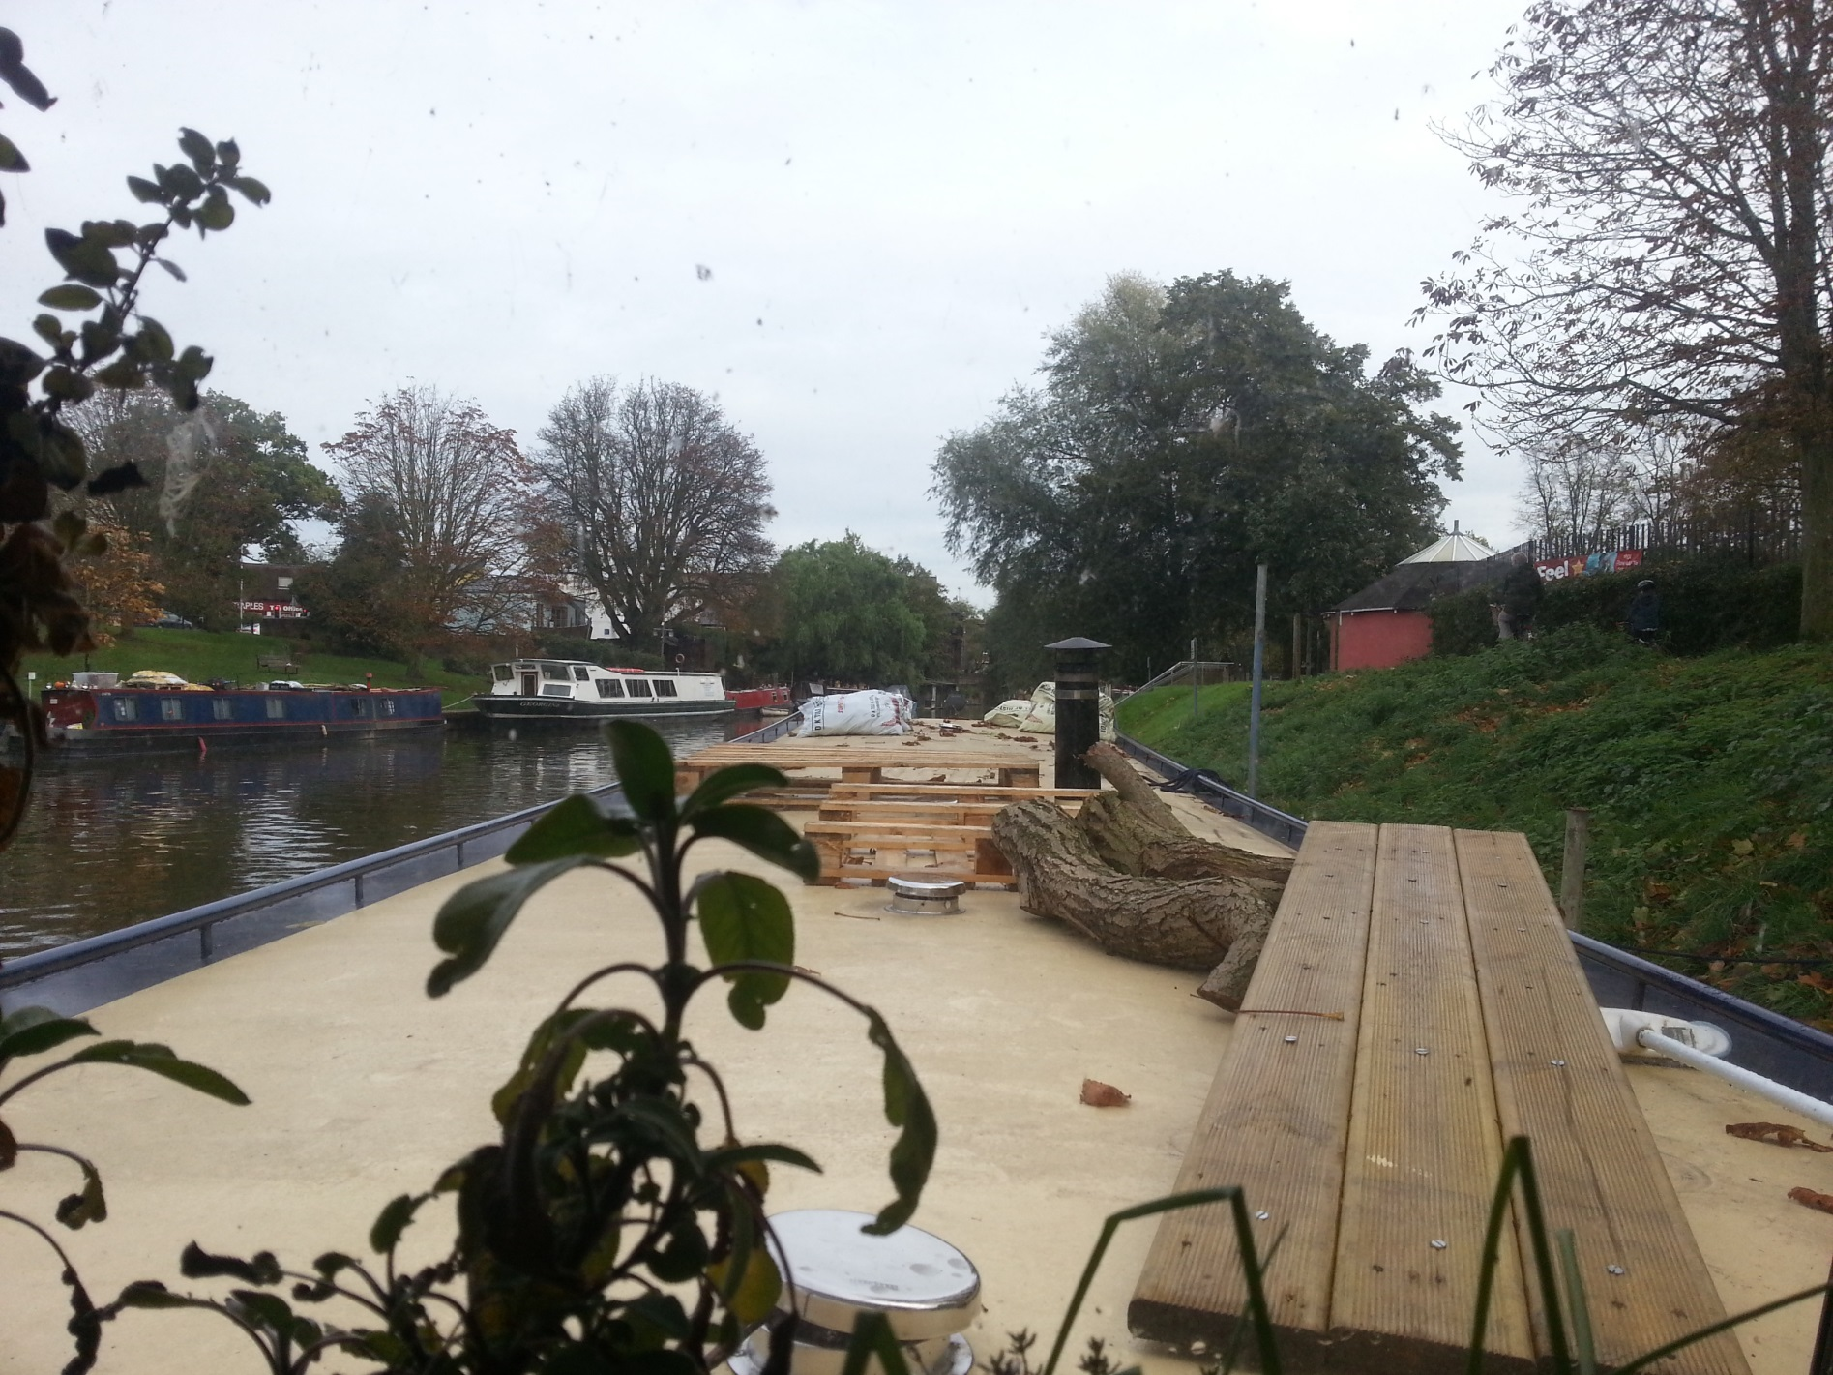

Slide 8
Moving Boats
Don’t stop or spin directly in front!
Visibility
Momentum/prop walk
Don’t assume they’ve seen you
Don’t assume they will stop or slow down
Channel- River depth
Railings/Riverside
Above Green Dragon bridge / Long reach
Overhanging foliage
Don’t undertake.

Slide 9
Overtaking
Can ask to come by, some can hear….
Don’t do it at cross over zones
Do you need to?
Are you stopping at the top of the Reach?
Is there other traffic around?
ASAP! But have a backup plan…
Be aware of stern swinging
Don’t cut hard into blind spot

Slide 10
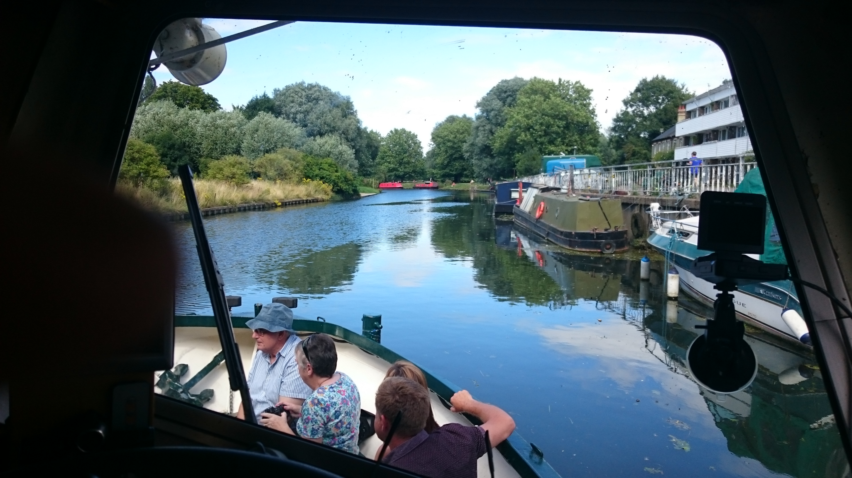

Slide 11
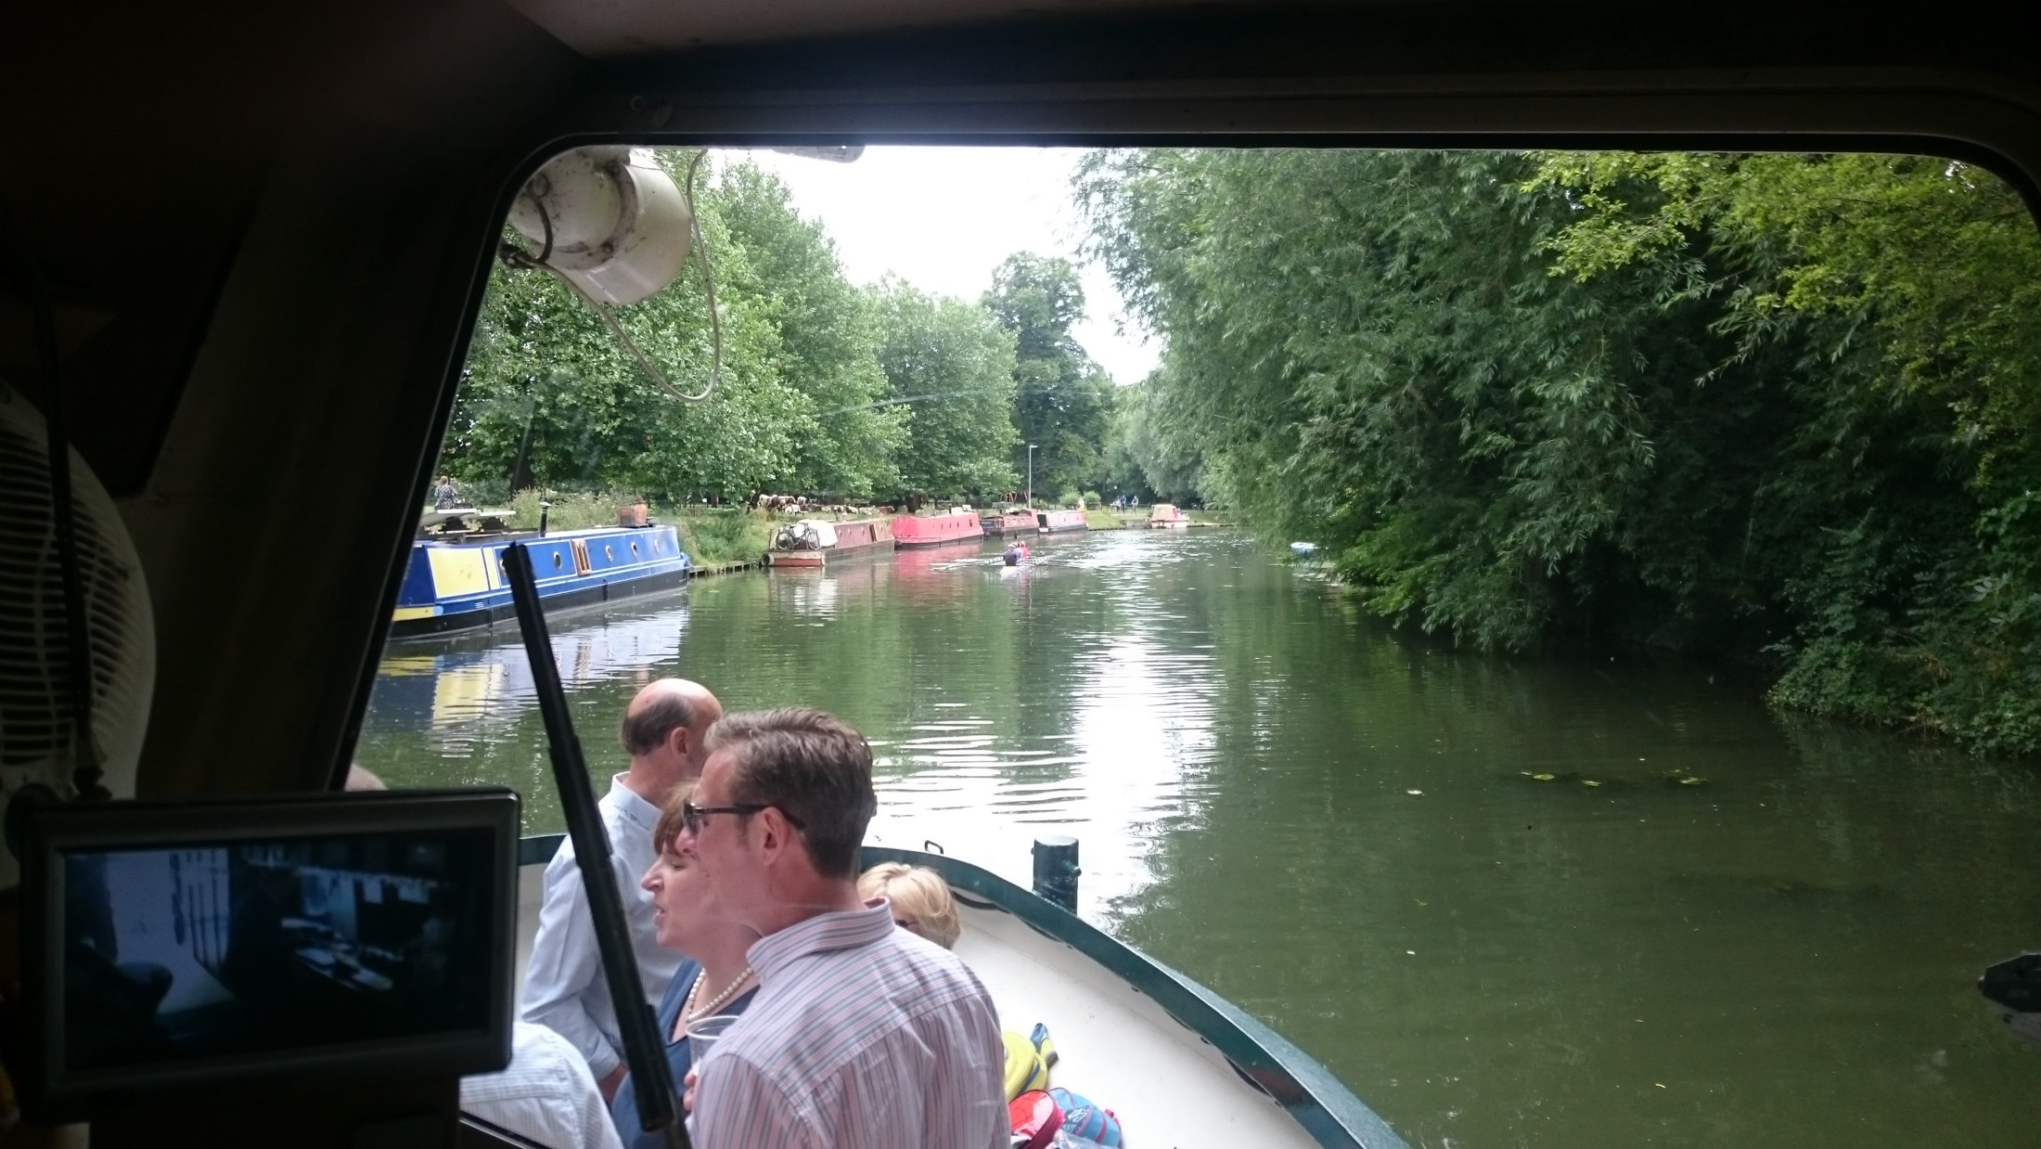

Slide 12
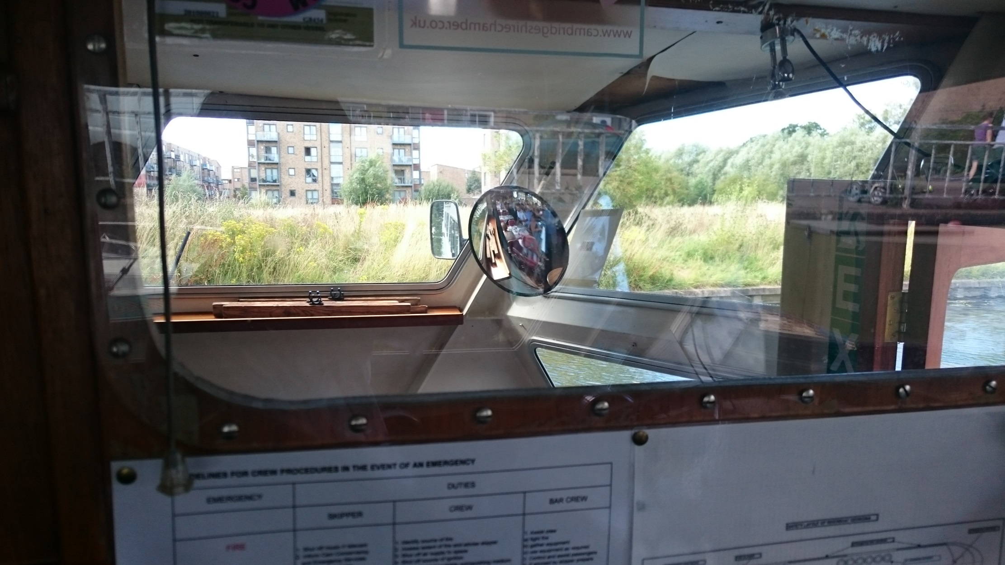

Slide 13
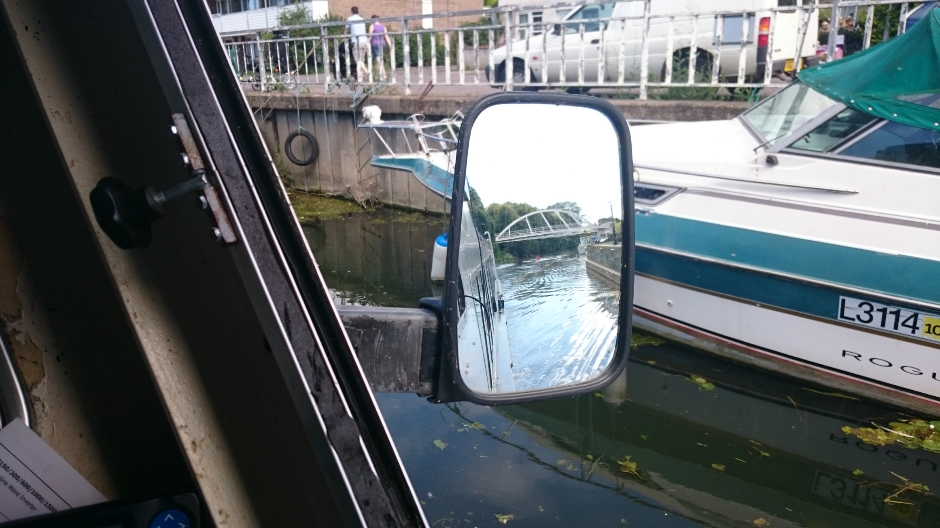

Slide 15
People being dicks….
Be polite, don’t swear back- or use derogatory language. Apologise if needed
Don’t escalate- leave if needed, report
Wildlife
Caution
Videoing
Acknowledge- “I’ve seen it, thanks”
Pause if needed
Wildlife guidelines

