Slide 1

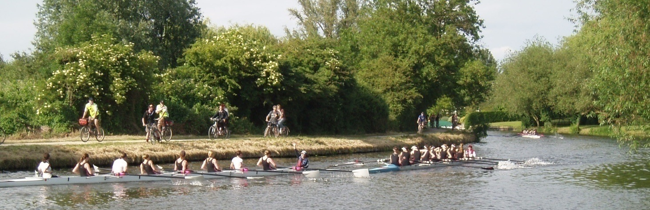
Coxing Bumps Races
Novice

Slide 2
Bumps is fun…!
BUT…
Potentially very dangerous
  Safety #1 priority!
Keep it sporting!

Slide 3
You must have…
Bow ball
Lifejacket
Without either of these, you will not be allowed to race!
Coxing Bumps Races - Novices
Notes:
If I can pull the bow ball off, it is not race legal.

Slide 4
Safety
Bowball - Firmly Attached
Steering Mechanism
  Rudder Wires
  Bent Fin/Rudder?
Heel Restraints
Life Jacket

Slide 5
Race Staff
Senior Umpires
Junior Umpires
  Will introduce themselves at the start.
  1 SU/JU per 3 boats.
  Can award bumps.
  Can instruct crews to concede, or stop at any time if necessary.
Marshals
  Assist umpires in marshalling crews.
Chief Umpire + Deputies
  Have final authority.
  Will make final decision in case of dispute.
Please listen to all instructions!

Slide 6
Marshalling

Slide 7
Marshalling Location
1st division of the day goes straight to the start.
All other crews marshal on towpath side, between P&E and the Railway bridge.
Reverse order (crew 1 furthest upstream).
Please follow marshal’s instructions.

Slide 8
Marshalling Time
M5 15 mins before start @ Baitsbite
Everybody else 45 mins before start.
LATE CREWS WILL BE HELD ABOVE THE BRIDGE AND POTENTIALLY SENT HOME
This is to ensure the safety of racing crews travelling towards the P&E.

Slide 9
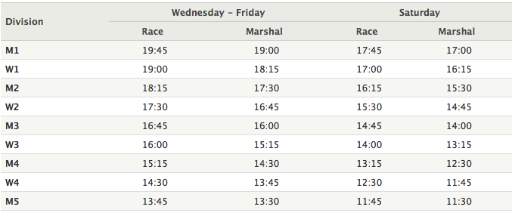
Be on time!

Slide 10
Rowing to the Start
Row down when told to by marshals.
Row down carefully on your side of the river.
  Crews returning, who may have sustained damage.
Keep in order.
1 practice start
  Outside the Plough only!
  If running late, may abandon practice starts (instructed by marshals).
Row up and spin on to your station – pull in to the bank.

Slide 11
The start

Slide 12
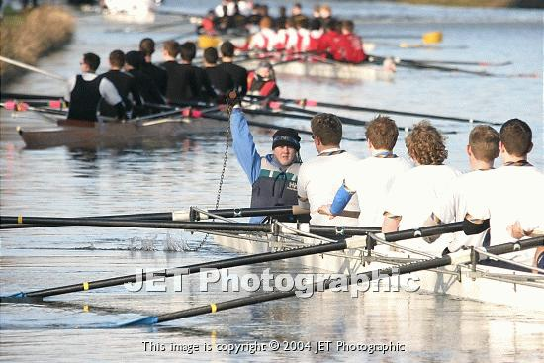
The Countdown
Your senior/junior umpires will introduce themselves to you.
Keep calm & in control of your crew.
4 minute gun
  Should be spinning or have spun by this point.
  Crew getting ready for start.
1 minute gun
  Everyone ready to go.
During the countdown, you must hold the bung up high for the umpires to see.
Coxing Bumps Races - Seniors

Slide 13
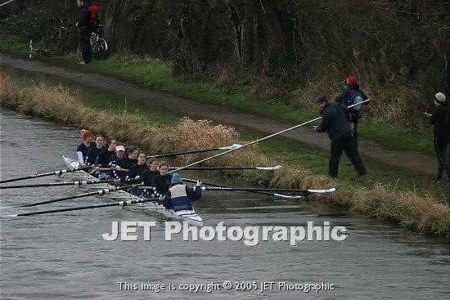
The Final Minute
Your bank party will push you out (about 30 seconds).
Hold on to your bung.
Hold it up high until start gun.
Keep your boat straight.
Notes:
Fines for dropped bung (no advantage)
If deliberate advantage gained more serious consequences.

Slide 14
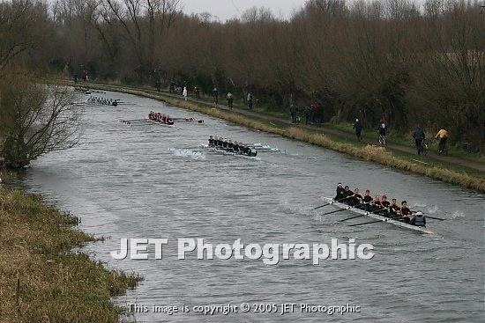
GUN!
Drop your bung and start racing!

Slide 15
Racing

Slide 16
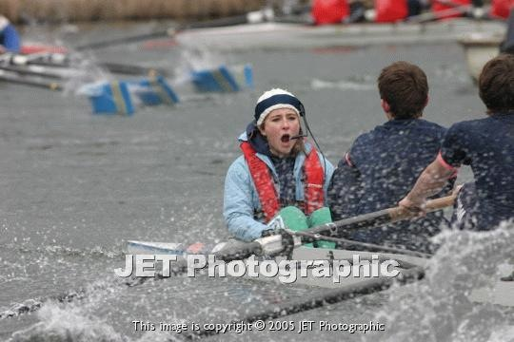
During the Race
Look in front and behind you.
  Look several crews in front: not just at the one you’re chasing.
  Crews will bump out ahead, often very quickly. You need to be aware of this, and be ready to steer/stop if necessary, especially round corners (umpires may tell you to go wide/stay tight).
  Don’t get tunnel vision!
Bumps is noisy - listen carefully to umpires and your bank party, they will give you useful information about what is ahead of you.
Keep calls short & to the point.
Try to focus on areas for a specific time to avoid confusion
Try and stick to your race plan
Follow the best line

Slide 17
How to Bump
Any contact from one crew on another.
  e.g. bow on stern, blade on stern, blade on blade.
Complete overtaking (bowball past bowball).
Between start & Grassy – bowball past cox.
Never row in to a stationary crew!
  Row past them and pull in.
  Hitting them is very dangerous – you will be fined/disqualified.
Your bank party will call distances as you get close to the crew in front, and many will use a sequence of whistles to indicate how close you are.

Slide 18
If you bump…
HOLD IT UP
As soon as other cox concedes (hand up) or instructed by umpire, hold it up hard, straight away.
Clear the river and pull in to the bank as soon as possible.
Do not let your crew celebrate until safely pulled in.
If you continue to row into a crew which has conceded, or celebrate early, you will be fined/disqualified! DO NOT DO THIS.

Slide 19
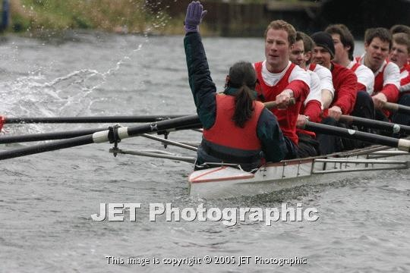
If you get bumped…
You are obviously going to push off any gaining crew and fight it to the last, but be sensible.
If the bump is inevitable, safer to concede early.
Acknowledge sensibly, fines are given for late acknowledgment so if you are bumped or are going to be bumped acknowledge.

Slide 20
If you get bumped…
Concede as soon as contact is made or an umpire awards the bump from the bank.
Wind it down, but keep paddling.
  Get out of the way of the crew which bumped you.
CLEAR THE RIVER
There will still be crews racing behind you.
Pull in as soon as you can/where instructed.

Slide 21
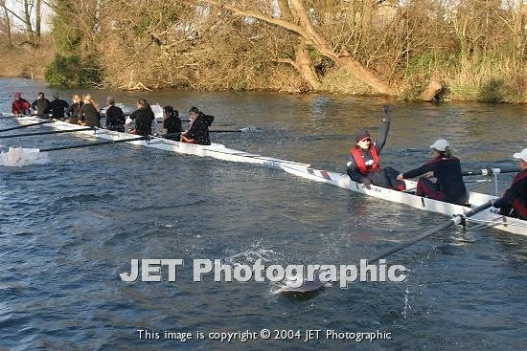
Making a Bump
Cox of crew getting bumped concedes by raising hand.
Bumping crew holds it up.
Bumped crew keeps rowing
  Wind down and pull in.

Slide 22
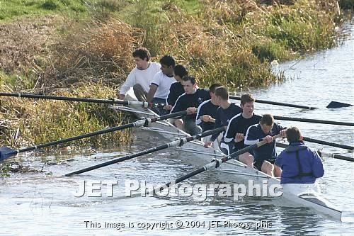

Slide 23
Clearing the River
You need to clear the river as quickly as possible after bumping/getting bumped.
Pull in to the bank as soon as you can/where instructed.
Keep firm control of your crew: get the appropriate people to take strokes and then paddle you into the bank.
Avoid parking on the inside of corners.
Failure to clear is extremely dangerous and will be severely penalised. If nothing else, remember that you will be the first person injured if a crew hits you from behind.

Slide 24
Once Parked
Keep control of your crew and boat.
Blades (and people!) need to keep clear of the towpath as there will be umpires and bankparties cycling through with crews who are still racing.
If on the bank, pull in riverside blades for racing crews if you need to.
If on the inside of a corner, bury riverside blades.
Call three cheers for the boat you have bumped/who have bumped you!
If you have bumped, you can collect some greenery but please do not strip the river bank of everything green.
Do not row home until all racing crews have come through and an umpire says that it is safe to do so.

Slide 25
Rowing Over
If you fail to bump & do not get bumped, you will have to ‘row over’ the entire course.
Crews 1-9 row to top finish.
Crews 11-18 row to bottom finish.
Crew 10 can choose (i.e. can chase a bump to top finish but stop at bottom finish if not).
Stern finish.
  Stern must cross line to be ‘safe.’

Slide 26
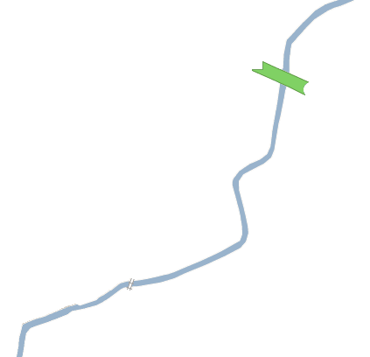
Know where your finish is!
 | Top Finish | Bottom Finish
Everyone | Post just downstream of Chesterton Footbridge (1) | Concrete post at Morley’s Holt (2)
2
1
Coxing Bumps Races - Novices

Slide 27
Rowing Home
When the last racing crew has passed, you will be told you can push off and row to the railway bridge (home if bumped above the railway bridge).
You will be held below the railway bridge until the next division have pushed off and rowed under it.
Again be careful: crews around you may have damaged equipment and the next division will be rowing down to the start.
Observe normal navigation rules
If you finish top of your division (either row over head, or bump the 1st boat), then you are the Sandwich boat, and will race again at the bottom of the next division up.
  The sandwich boat must spin and pull in near the Railway bridge to marshal for the next division.
  Obey marshals instructions as to timing when to spin.
Coxing Bumps Races - Novices

Slide 28
safety measures

Slide 29
Carnage!
Keep watching what is ahead and if necessary…
HOLD IT UP
NEVER row in to a stationary crew!
If you have to stop while racing, we can award technical results
Coxing Bumps Races - Novices

Slide 30
Sirens
There are static umpires positioned along the course up to Grassy.
If a division must be stopped (due to severe carnage, ejector crabs…) then they will be told by the chief umpire to use the sirens.
If your boat has yet to pass the marshal sounding a siren then you MUST stop immediately.
If you hear a siren sounding behind you, continue to race.
Coxing Bumps Races - Novices

Slide 31
What if…
…the rudder breaks?
  (or one of your rowers drops out & you can’t get round the corner)
  STOP! If you are able to continue, it will be quicker to stop, straighten up and go again than to drive into the nearest bank.
  Do not attempt to race with no rudder!
…someone catches a crab?
  get his/her partner to drop out; if they still can’t get the blade back, you will need to stop so they can get it back.
Always prioritise safety. Bumps is no fun when people get hurt.
Coxing Bumps Races - Novices

Slide 32
Kit
It could be quite sunny. It could be horrible!
There may be long waits while marshalling or before you can row home.
Take shoes in the boat so you can get out while marshalling and move around.
Lifejackets! Without one you won’t race!

Slide 33
Etiquette
Lots of people come to watch bumps, including members of the public.
  A certain standard of behaviour is expected of all racing crews.
Foul and abusive language and behaviour will not be tolerated.
If another crew or bank party are aggressive or abusive report it to a JU or SU. Do not get drawn into arguments.
Remember that you are representing your college and the University.
Coxing Bumps Races - Novices

Slide 34
Penalties
Failure to follow rules of racing will result in fines.
Incidents of a serious nature will be dealt with severely: coxes and crews can be disqualified, bumps can be disallowed.
Each bumps, many many fines are awarded for simple things like failure to concede, failure to hold it up and, most of all, failure to clear.
Coxes are the most vulnerable people during bumps.
Bumps can be very dangerous - the rules are there to make racing safe and enjoyable for all crews.
Coxing Bumps Races - Novices

Slide 35
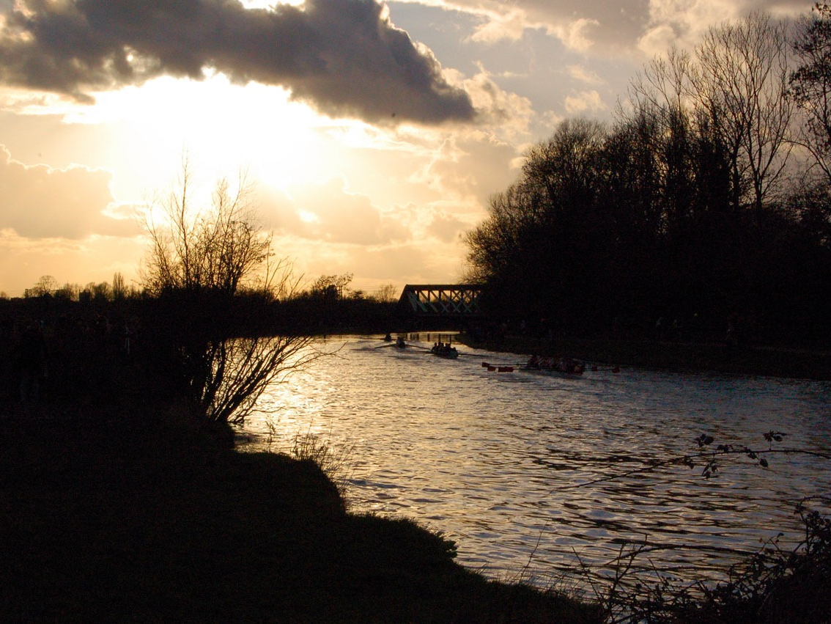
Thank you
Any questions?
robert@cucbc.org

