Slide 1
CLARE NOVICES’ REGATTA 2015 2016 2017 2018 2019 2022
COXES’ BRIEFING
ROZALIE RYCLOVA JON SWAIN
TOM HILBOURNE RUARIDH MACDOWALL
JAMES BRADLEY Sam Taylor, SENIOR UMPIRE

Slide 2
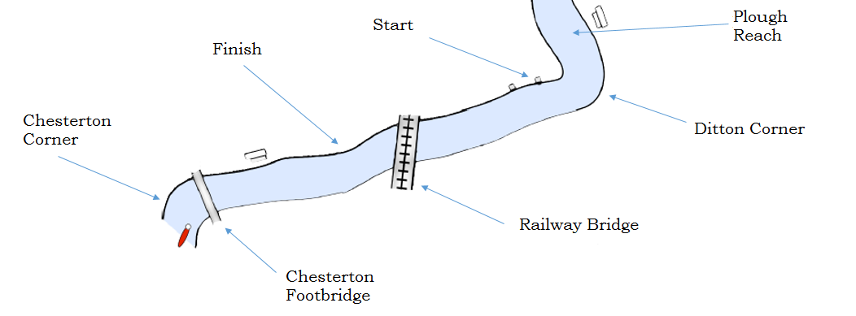
RACE COURSE
Approx. 800m, side-by-side, standing start, knock-off format
Notes:
Bit like Emma sprints really, except slightly longer
Boats will be disqualified if the cox does not have a lifejacket or no bow ball is present

Slide 3
RACE COURSE
Notes:
Upstream boats have priority in normal river navigation

Slide 4
MARSHALLING ARRANGEMENTS
Note: Special arrangements for the first division
Notes:
Arrive at the Chesterton footbridge BEFORE your marshaling time. Bank up on the right at your marshal station (marshals will be on hand in orange to help)
Push off when instructed and row down to the plough reach. A racing start will be permitted under the railway bridge if time permits
Spin at the plough reach and pull in at the same marshal station number
Push off when instructed and row down to the start line
You are now under starters orders – Get yourself straight and in line according to the start marshals
Start racing when instructed! Keep your line and listen to the race umpires – They are in charge during the race
Keep your line to the finish – A horn will sound when the winner passes the finish line
If you win – Pull into the P and E on the right. Marshals will push you off when the division is finished, row down at the back end of the next division
If you lose, keep on rowing home – This is a knockout competition after all ☹

Slide 5
A BOAT MARSHALLING
Notes:
How exciting!

Slide 6
CNR SUMMARY
1. Boats bank up in reverse racing order at Chesterton
2. Boats row up in reverse racing order (with a practice racing start under railway bridge if time allows)
3. Boats arrive at Plough Reach, spin at station (first pair at start station at bottom of the Reach)
4. Race
5. Finish – boats go home if knocked out
Notes:
Simple

Slide 7
STUFF TO REMEMBER
Listen to marshals’ instructions when banking up on station at the P & E or on Plough Reach - Doing everything swiftly makes life a lot easier
If time allows, enjoy a cheeky practice start under the railway bridge on the row down. Marshals will advise if this is possible
Listen to the start umpires when at the start line – They’ll help get crews level. Start sequence is the usual Jesus…FAT….Attention… GO
Winning crews will spin at the P & E (marshals will give details). Losing crews row straight back to the boathouses after racing
Notes:
Just listen to the marshals

Slide 8
CLOTHING
It’s probably going to be cold (this is November after all). You and your crew will be static for several minutes will marshalling so YOU MUST bring lots of warm clothing. Crews will have the opportunity to de-layer at the Plough Reach before marshalling.
We have a not-at-all-professional photographer (a keen guy with a phone) for those all important rowing pictures, so looking pretty fly may also be a consideration.
Notes:
Seriously bring lots of clothing

Slide 9
Beware the Crab

Slide 10
FINALLY
Have a good race
Ask the marshals if in doubt
Prize giving 16:15 at Clare Boathouse
Any queries can be sent to: claregatta@gmail.com

