Slide 1

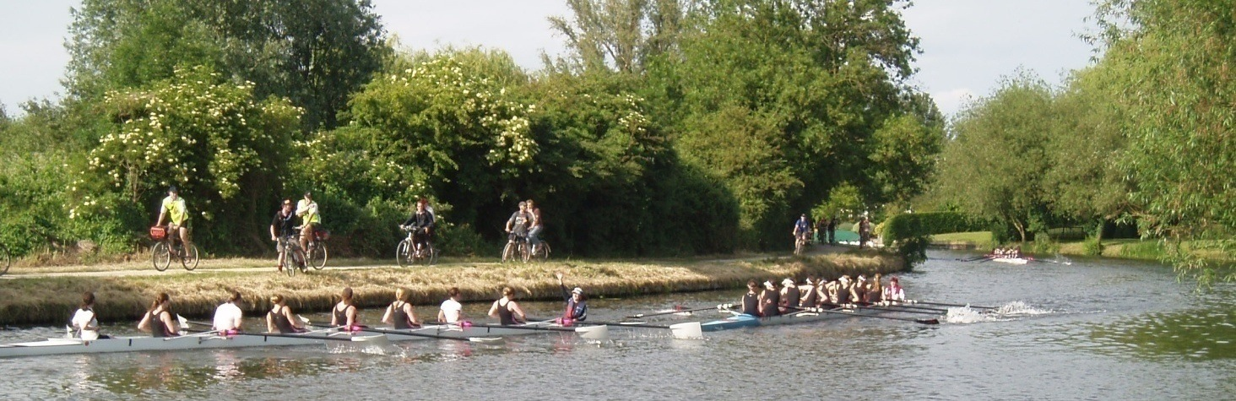
Coxing on the Tideway
WEHoRR/ManHoRR 2016

Slide 2
Tidal Water
Tideway is … tidal!
Stream much greater than on Cam.
Changes direction 4 times a day.
Used by big boats (though closed during racing).
Rules are more complex.
Coxing on the Tideway

Slide 3
Things To Look At Before the Day
Race instructions from WEHoRR/HoRR
Navigation on the River Thames
Produced by Thames Regional Rowing Council,
Horrifically long… (120 pages!)
Handy 1 page summary available!
https://www.youtube.com/watch?v=RSl8XiXfpng
(Coxing a Tideway Head)
Race plan (if you feel that way inclined…)
Coxing on the Tideway

Slide 4
Things To Take
Wellies.
All the warm clothes.
All the waterproofs.
BR race licence.
Charged cox box. Life jacket.
Food/drink.
Change of dry clothes for afterwards!
Boat (with flotation compartments and heel restraints).
Coxing on the Tideway

Slide 5
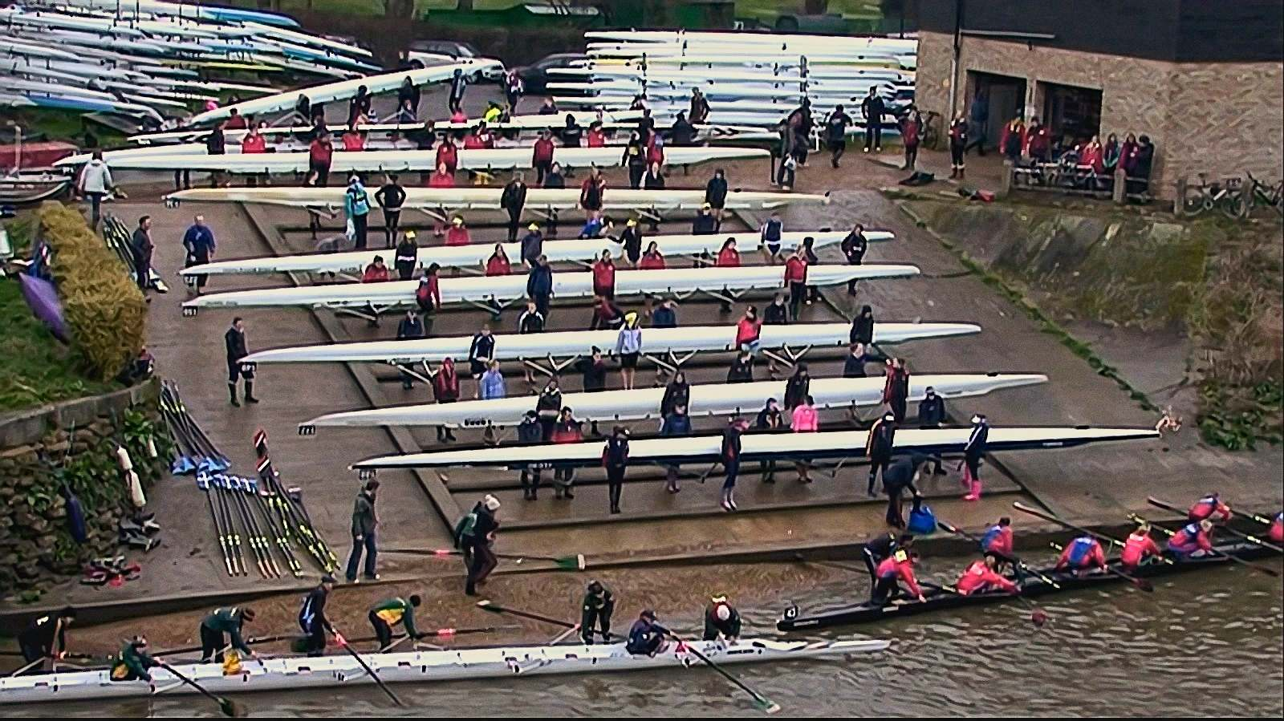
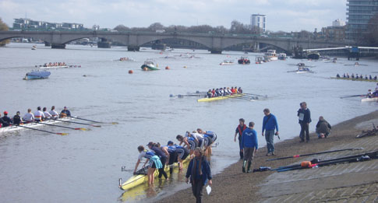
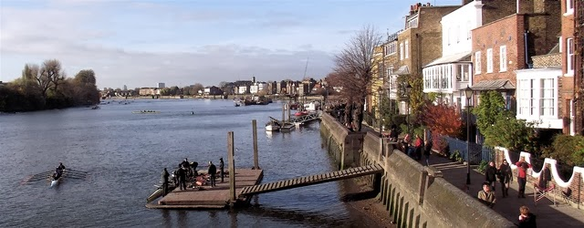
Boating
Coxing on the Tideway

Slide 6
Getting To The Start
Allow plenty of time! (~1 hour from Putney, plus boating time).
Know where you want to end up.
Be flexible about the warm up.
Coxing on the Tideway

Slide 7
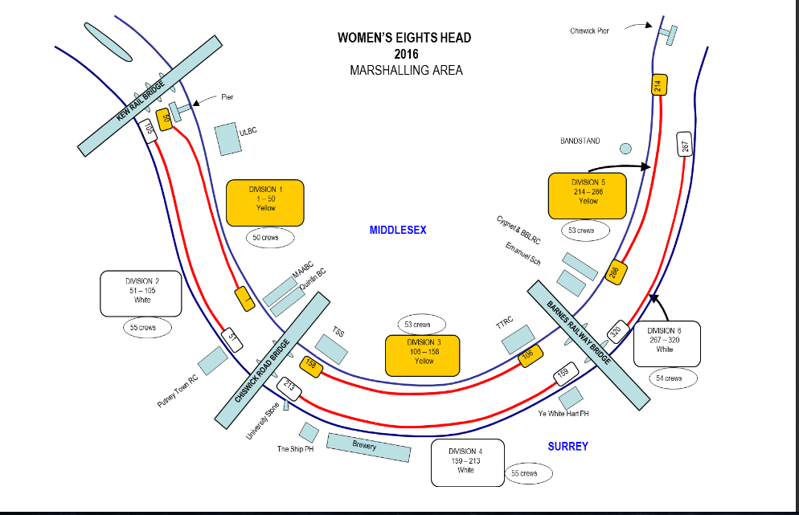
Getting To The Start
Coxing on the Tideway

Slide 8
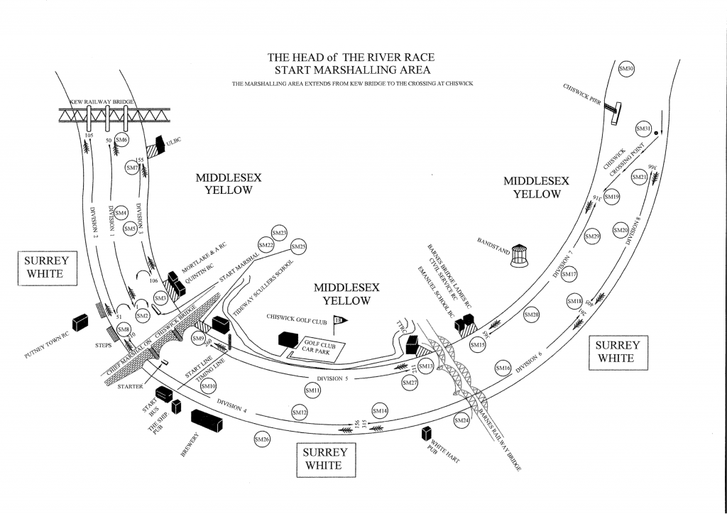
Getting To The Start
Coxing on the Tideway

Slide 9
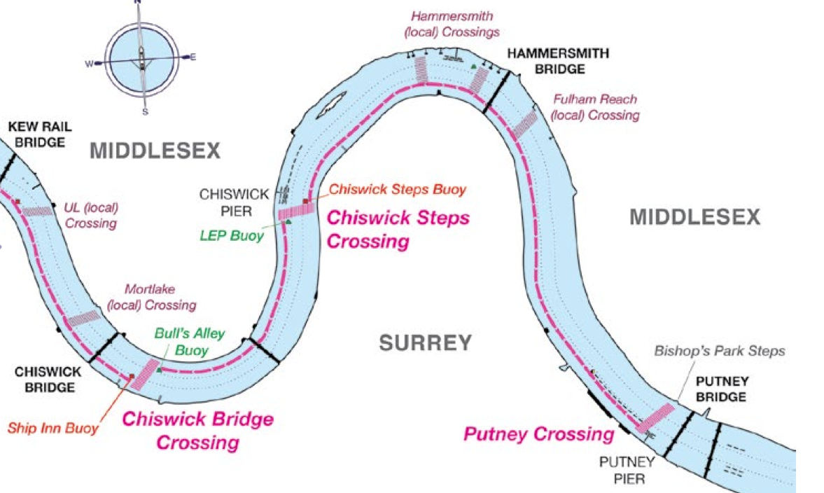
Getting To The Start
Coxing on the Tideway

Slide 10
Marshalling
Again … stream! Keep moving up.
Act early if drifting.
Make sure rowers have kit.
Listen to ‘Shouty Man’.
Stay tucked into the bank.
Watch for idiots.
Coxing on the Tideway

Slide 11
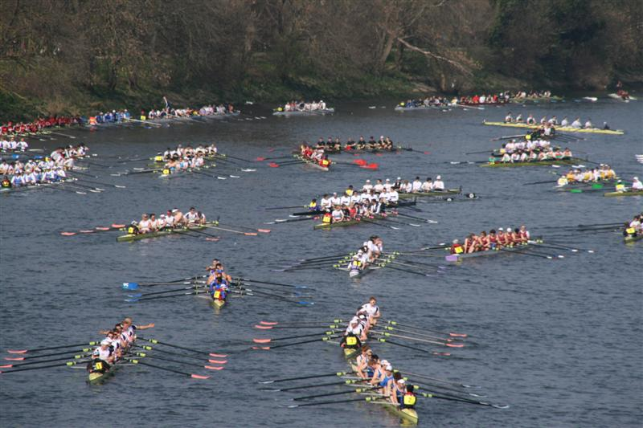
Marshalling
Coxing on the Tideway

Slide 12
(Pre-)Racing!
De-kit instructions will usually be issued ~5 mins before racing
Turn in order.
Spin into the centre by rowing on with one side for several strokes while the other side holds. Aim to be in the middle when done.
Coxing on the Tideway

Slide 13
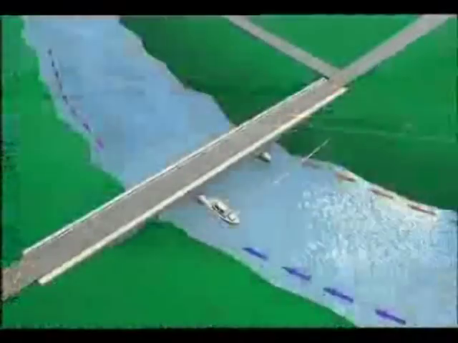
(Pre-)Racing!
Coxing on the Tideway

Slide 14
Racing!
Go fast, have fun!
Coxing on the Tideway

Slide 15
After The Finish
Keep moving!
Listen to ‘shouty man’.
Coxing on the Tideway

Slide 16
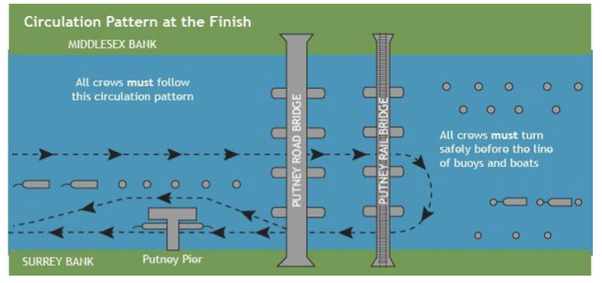
After the Finish
Coxing on the Tideway

Slide 17
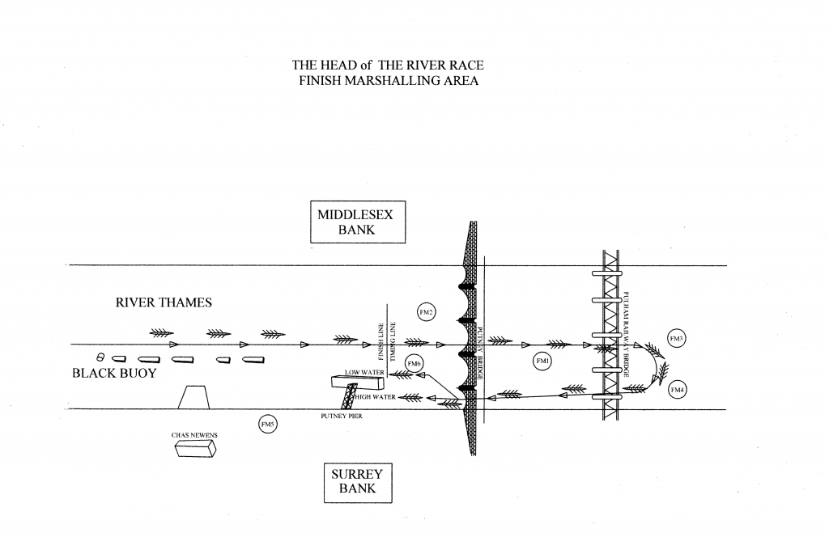
After The Finish
Coxing on the Tideway

Slide 18
Rowing Home
Very similar to the row to the start, but more tired...
If further down the start order, keep an eye out for large boats as the river re-opens.
If high up the start order, crossing may involve moving through gaps between racing crews.
Coxing on the Tideway

Slide 19
Rowing Home
Coxing on the Tideway

Slide 20
Weather
May be wet. Be prepared.
May be windy.
Wind vs Stream. ☹ ☹ ☹
Coxing on the Tideway

Slide 21
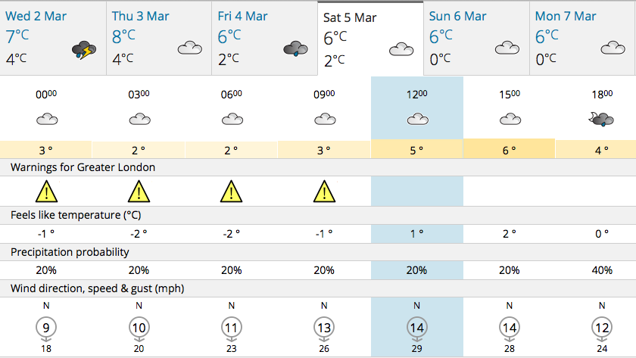
Weather
Coxing on the Tideway

Slide 22
Weather
Coxing on the Tideway

Slide 23
The Stream (again)
Please take care when manoeuvring round buoys or near bridges. Stream will push you back onto things downstream. Hard immobile things.
Especially true when crossing the river through the centre (with stronger stream).
Don’t be these people…
Coxing on the Tideway

Slide 24
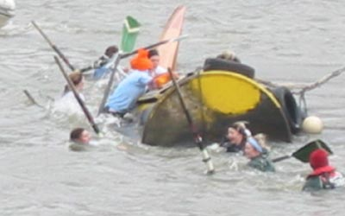
The Stream (again)
Coxing on the Tideway

Slide 25
Pre-Paddle
Short outing ahead of the race to familiarise crew with the choppier water and size of the river.
The stream may well be in the opposite direction to during racing.
The river will *not* be closed.
Seek advice first (your host club are ideal to ask).
Coxing on the Tideway

Slide 26
Have Fun!
Any questions?
robert@cucbc.org

